Slide 1
Activity-6
RECOMMENDATION SYSTEM

Slide 2
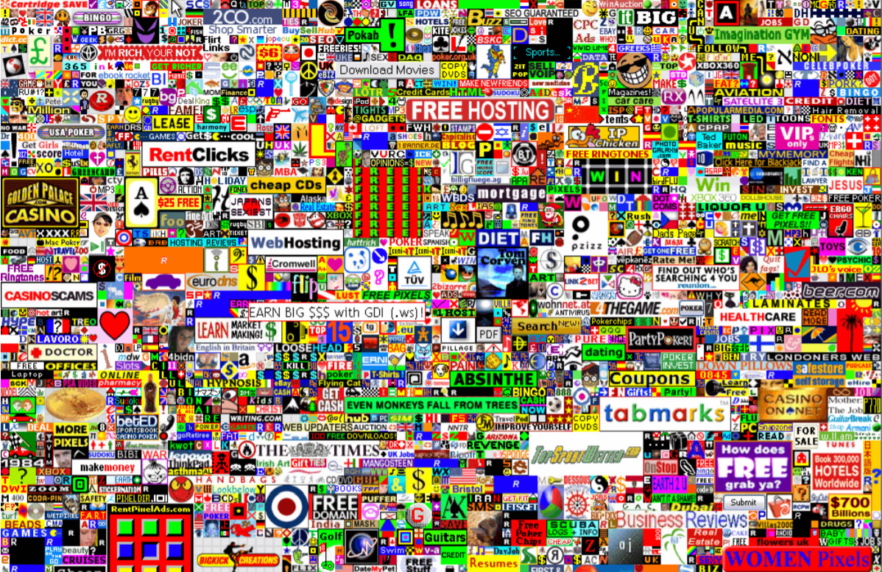
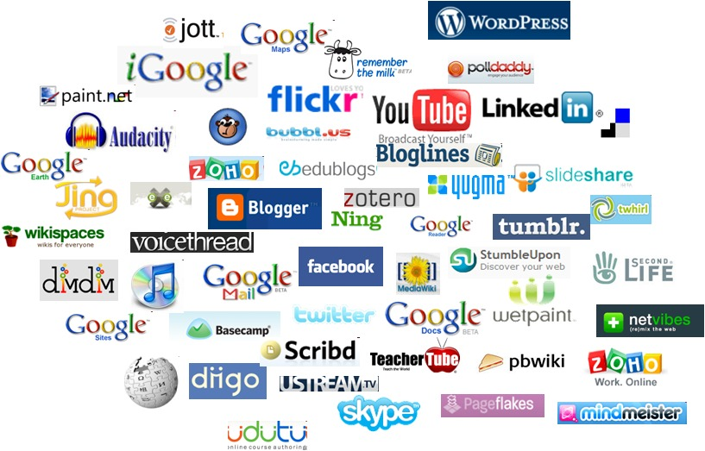
The world is an over-crowded place

Slide 3
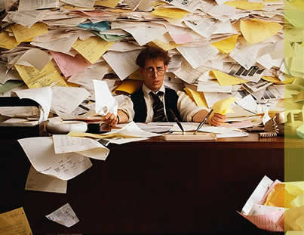
We are overloaded
Thousands of news articles and blog posts each day
Millions of movies, books and music tracks online
> 857 TV channels in India, thousands of programs each day
Several thousands of ad messages sent to us per day
Thousands of food recipes from thousands of restaurants everyday

Slide 4
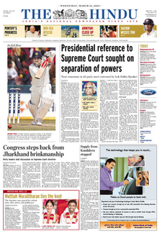


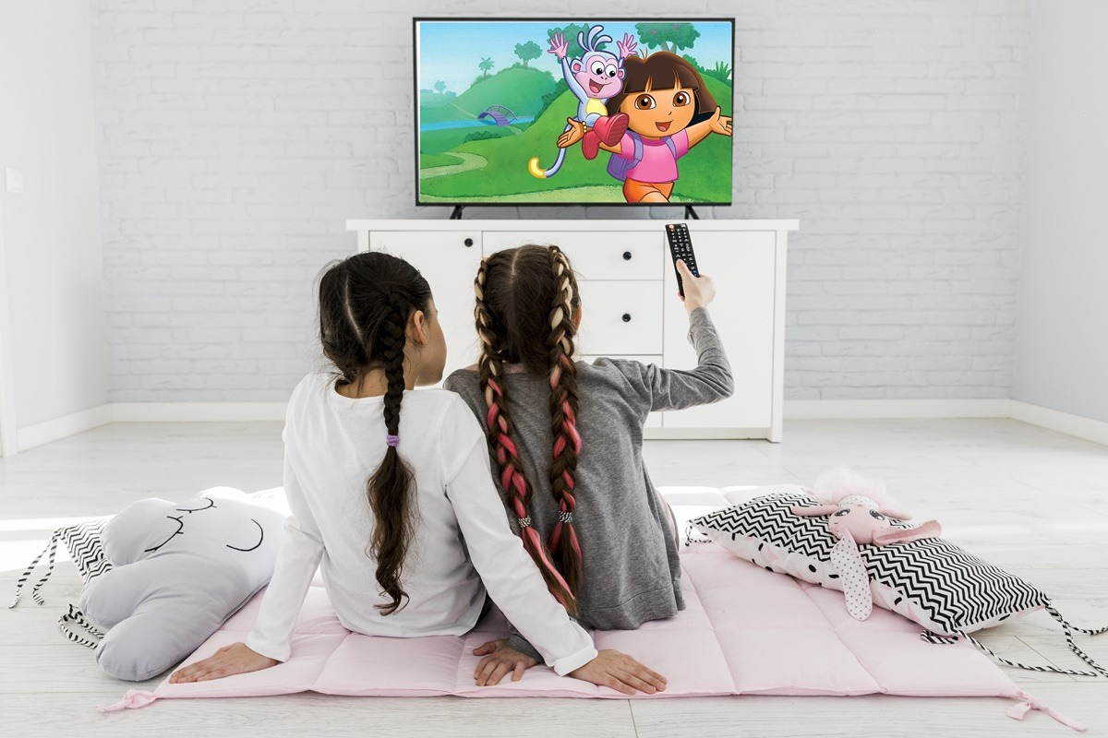
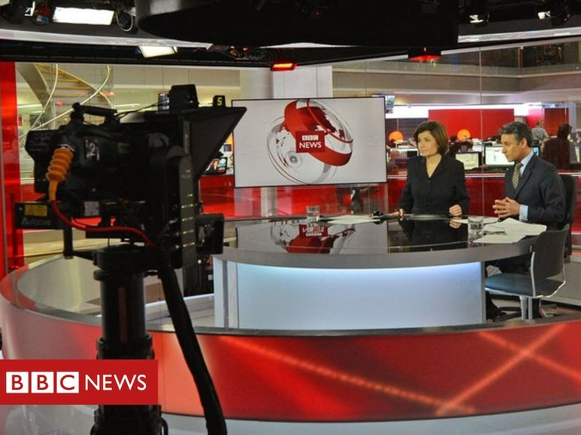
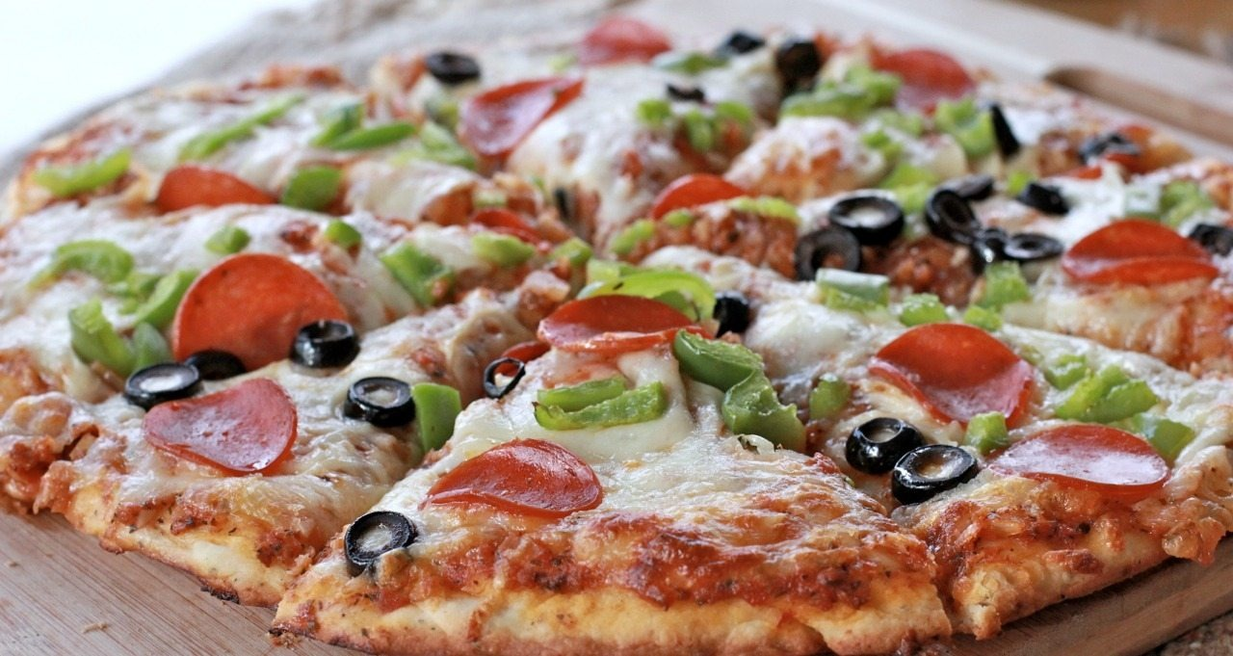
But we really need and consume only a few of them..!

Slide 5
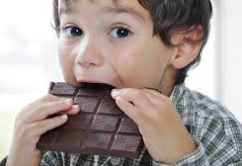
Sometimes, all we need is this
Do not disturb…!

Slide 6

Sometimes People don’t know what they want until you recommend it to them.
Can experts help?
Yes, but it won’t scale well
It is what they like, not me!

Slide 7
OK, here is the idea called Recommendation System:
To recommend to us something we may like
How?
– Based on our history of using services
– Based on other people like us

Slide 8
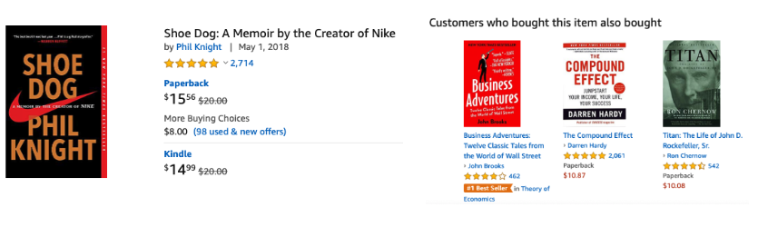
Examples of recommendation systems
Amazon
I intended to buy ‘Shoe Dog’ but ended up buying ‘The Compound effect’ too!

Slide 9
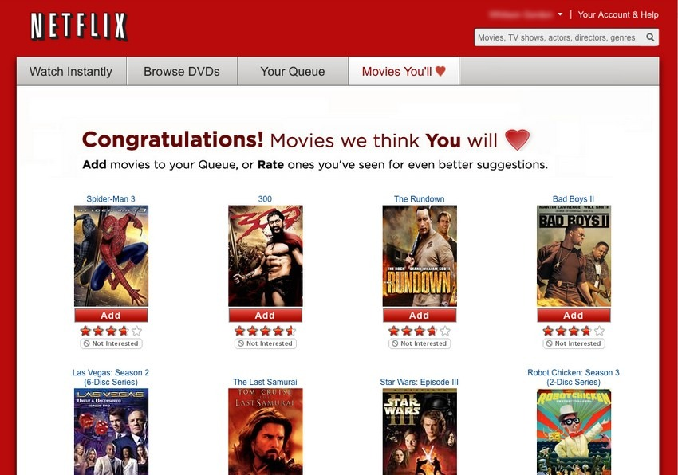
Netflix
Examples of recommendation systems

Slide 10
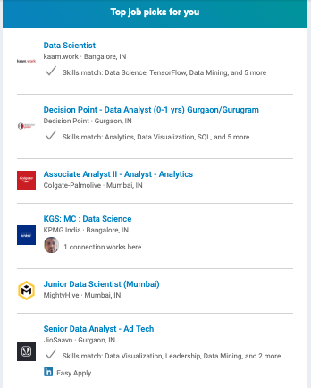
Linkedin utilizes data from your experience, current job titles and endorsements to suggest probable jobs to you
Examples of recommendation systems

Slide 11
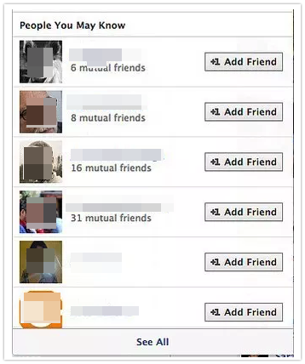
Facebook - recommends friends connections
Examples of recommendation systems

Slide 12
Examples of recommendation systems
Spotify
YouTube
Amazon Prime Video
Trip Advisor
Google News
Many other platforms continuously give out recommendations and suggestions to suit our needs.

Slide 13
what do recommendation systems do, exactly?
Predict how much you may like a certain product/service
Compose a list of N best items for you
Compose a list of N best users for a certain product/service
Explain to you why these items are recommended to you
Adjust the prediction and recommendation based on your feedback and other people

Slide 14
Nearest Neighbour Classifier
How computers know what we really want ?
When given an item to classify, it finds the training data item that is most similar to the new item, and outputs its label.
Training Data Set
Test Data Set

Slide 15
Activity - 1
Build a simple recommendation system for an online shopping application
We have data from six users.
Training data
User | Shopping History |  |  |  | Recent Purchase
Harshith | Story book | Smart Phone | headphones | sunglasses | coffee beans
Varshini | t-shirt | coffee beans | coffee maker | coffee beans | coffee beans
Ananya | sunglasses | sneakers | t-shirt | sneakers | socks
Bia | Electronic Toy | headphones | t-shirt | Story book | Shoes
Hasini | t-shirt | Shoes | sunglasses | Smart Phone | sunscreen
Thashvitha | Smart Phone | coffee beans | Electronic Toy | headphones | coffee beans
Notes:
The users' purchase history is recorded and used to predict which products the user is likely to buy next.

Slide 16
Predict the next purchase of a customer
Our task is to predict the next purchase of customer Mithra who has bought the following products:
Test data
User | Shopping History |  |  |  | Next Purchase
Mithra | green tea | t-shirt | sunglasses | Shoes | ?

Slide 17
How to predict the next purchase of a customer
To apply the nearest neighbor method, Let’s use the shopping history to define the similarity (“nearness”) by counting how many of the items have been purchased by both users.
Proceed as follows:
Calculate the similarity of Mithra relative to the six users in the training data (done by adding together the number of similar purchases by the users).
Having calculated the similarities, identify the user who is most similar to Mithra by selecting the largest of the calculated similarities.
Predict what Mithra is likely to purchase next by looking at the most recent purchase (the rightmost column in the table) of the most similar user from the previous step.

Slide 18
User | Shopping History |  |  |  | Recent Purchase | Similarity
Harshith | Story book | Smart Phone | headphones | sunglasses | coffee beans
Varshini | t-shirt | coffee beans | coffee maker | coffee beans | coffee beans
Ananya | sunglasses | sneakers | t-shirt | sneakers | socks
Bia | Electronic Toy | headphones | t-shirt | Story book | Shoes
Hasini | t-shirt | Shoes | sunglasses | Smart Phone | sunscreen
Thashvitha | Smart Phone | coffee beans | Electronic Toy | headphones | coffee beans

Slide 19
Who is the user most similar to Mithra?
What is the predicted purchase for Mithra?

Slide 20
Which of the following recommends friends
Test Your Knowledge
Google News
Netflix
Facebook
You Tube
C) Facebook

Slide 21
In what way, the amazon recommendation system help the people?
Test Your Knowledge
Based on the previous history of purchase and people who buy similar products, it recommends future product purchase
It recommends the movie they like
Based on the personal profile it suggests the job
Recommends the news they want to read
(a)

Slide 22
An application that provides recommendation for your drawing
Test Your Knowledge
MS Paint
Autodraw
Netflix
Spotify
b) Autodraw

Slide 23
What method is used in the activity-1 to predict the next purchase of a customer
Test Your Knowledge
Content filtering Method
Nearest Neighbor Method
Personality Method
Graph based Method
(b) Nearest Neighbor Method

Slide 24




Match the items with the following recommendation systems
Test Your Knowledge
Amazon Jobs
LinkedIn Movies/TV shows
Facebook Products,e.g.books
d) Netflix People/Friends

Slide 25
What can be recommended by Machines/Computers?
Advertising messages
• Investment choices
• Restaurants
• Cafes
• Music tracks
• Movies
• TV programs
• Books
• Cloths
• Supermarket goods
• Tags
• News articles
• Future friends • Courses in e-learning
• Drug components • Research papers • Citations
• Code modules
• Programmers

Slide 26
Your Task - 1
Build a simple recommendation system
Collect data from 10 friends – Training Data
Collect data from 1 friend whose next purchase to be recommended – Test data
Apply nearest Neighbor classifier
Find the next purchase to be recommended

Slide 27
An application that provides recommendation for your drawing is Autodraw.
Your Task-2
Experiencing MS paint
https://www.autodraw.com/

Slide 28

Thank You…!

